Slide 1
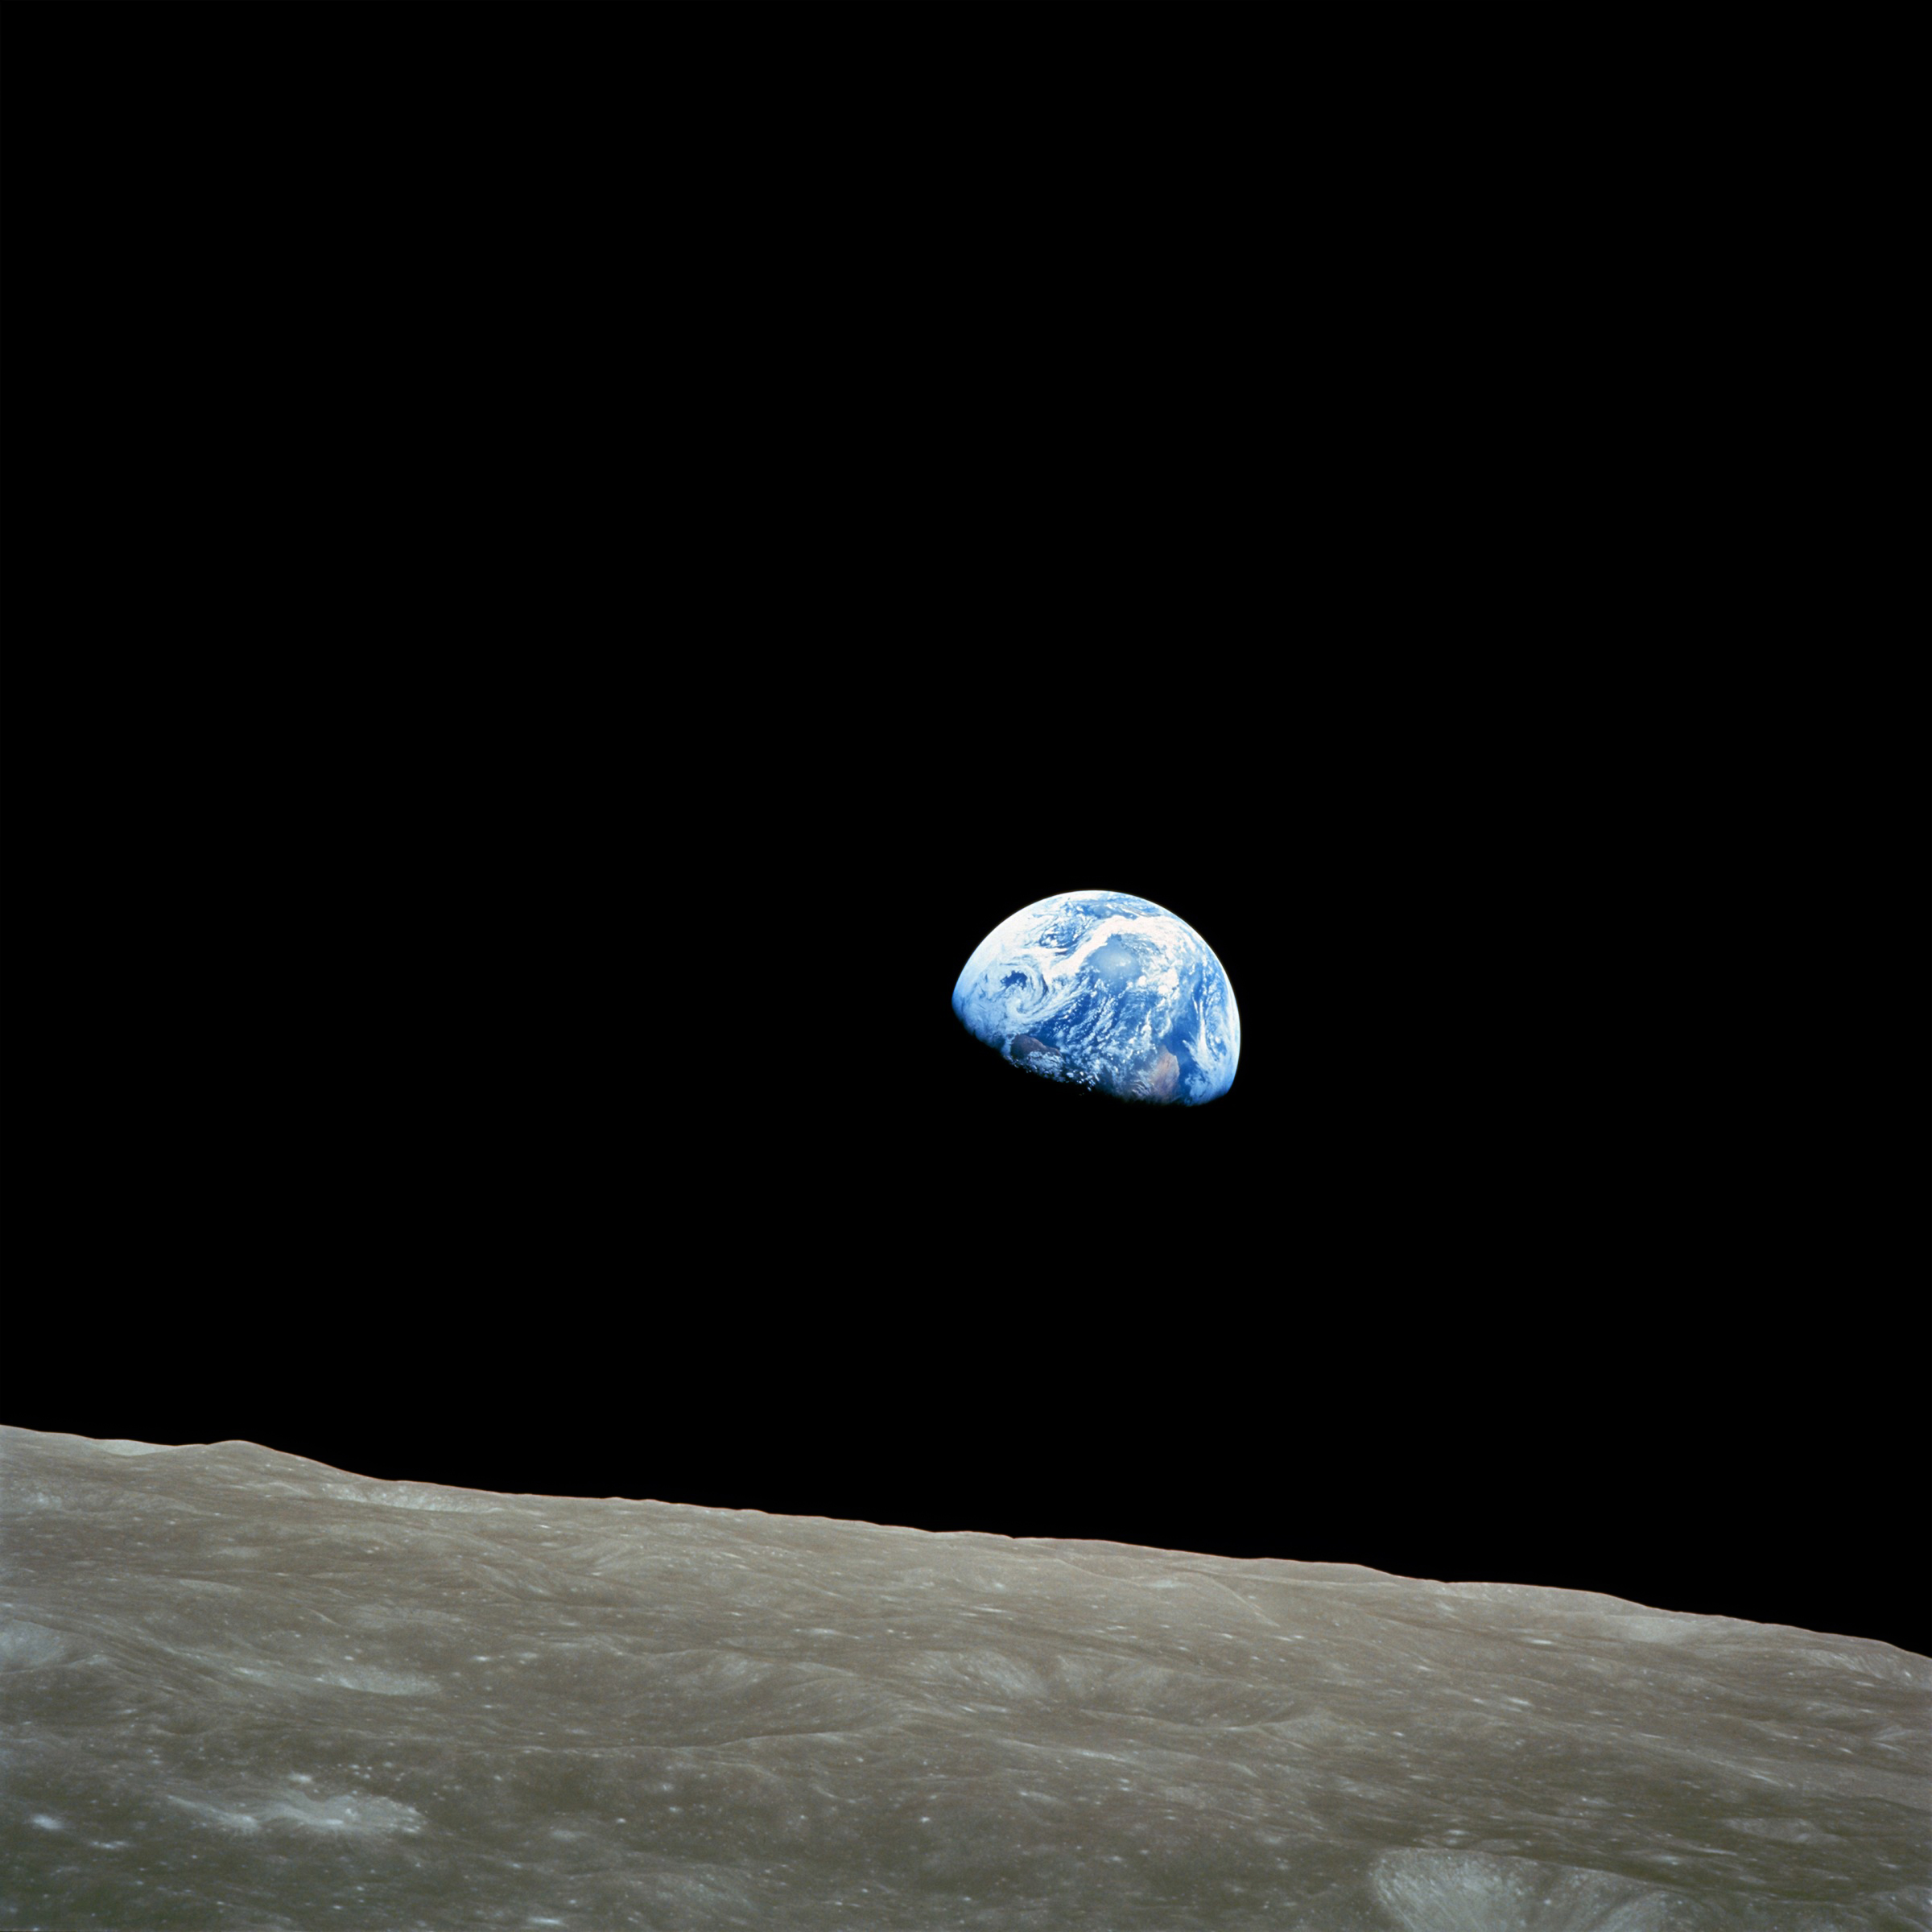

Lunar LottO
jared Dylan & Jordan Clayton

Slide 2
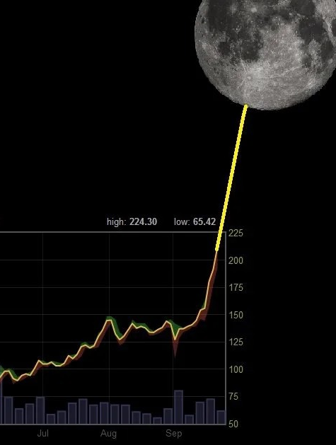
Hypothesis
If you buy on the full moon and sell on the New Moon, then you will profit more than if you buy & hold

Slide 3
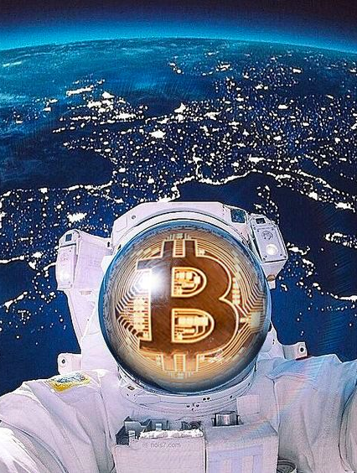
The Big Q’s
What don’t we know?
What is the correlation between the lunar phases and the local highs and lows of BTC
Can the lunar cycle be used as a trade indicator
What is the correlation between the lunar cycle and the fear index

Slide 4
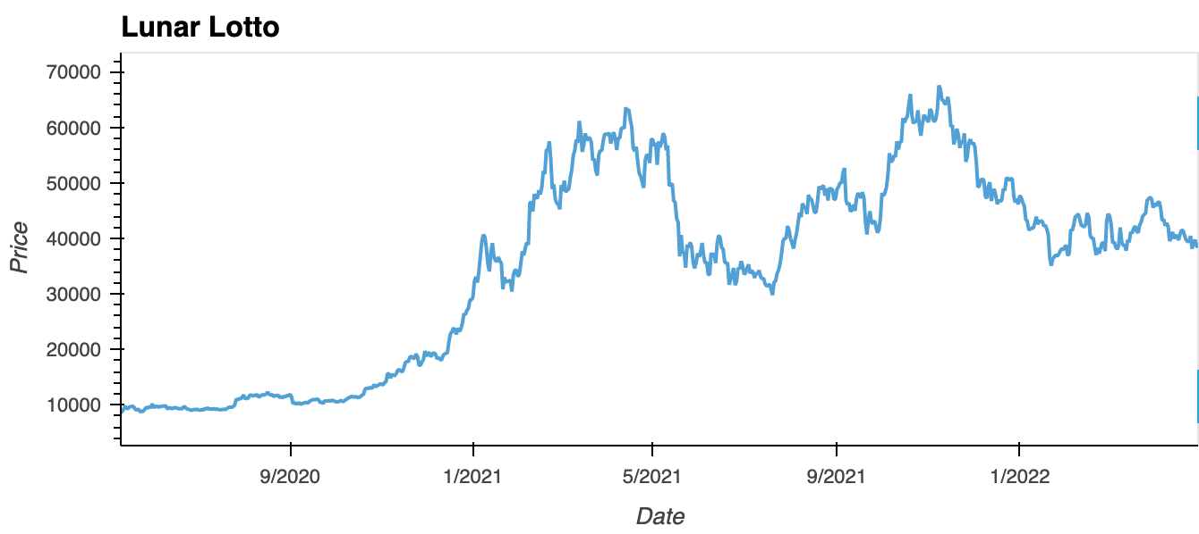
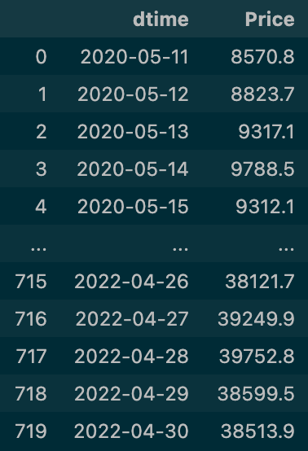
BTC Price DATA

Slide 5
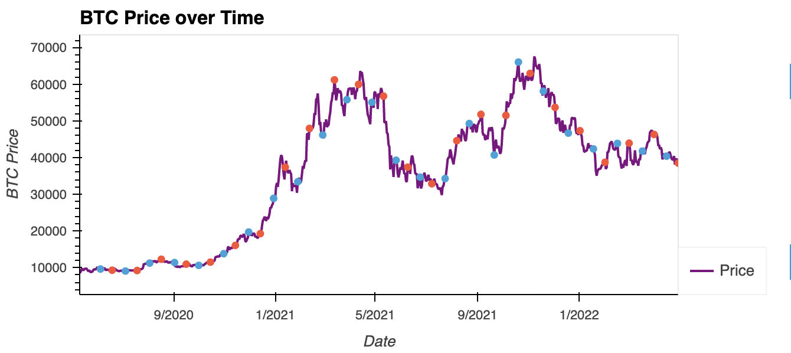
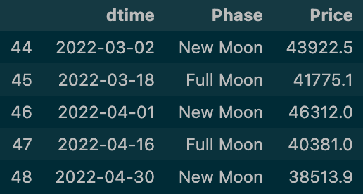
Lunar Data

Slide 6
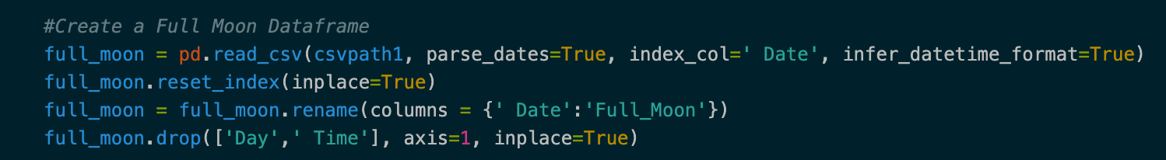
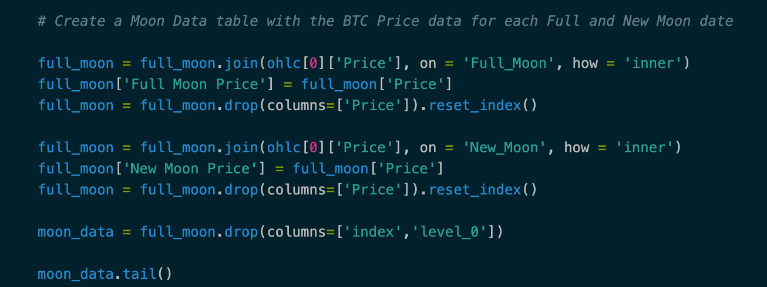
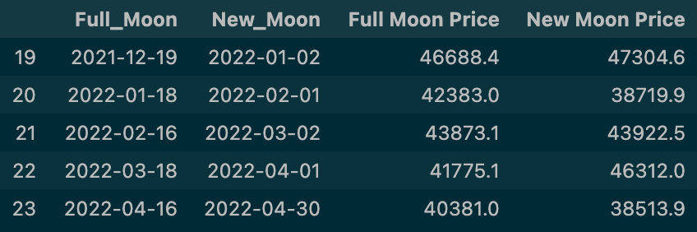
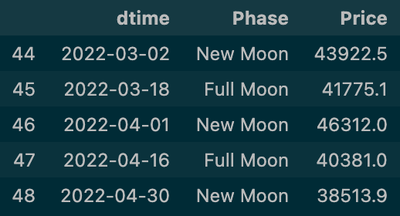
Data Cleaning

Slide 7
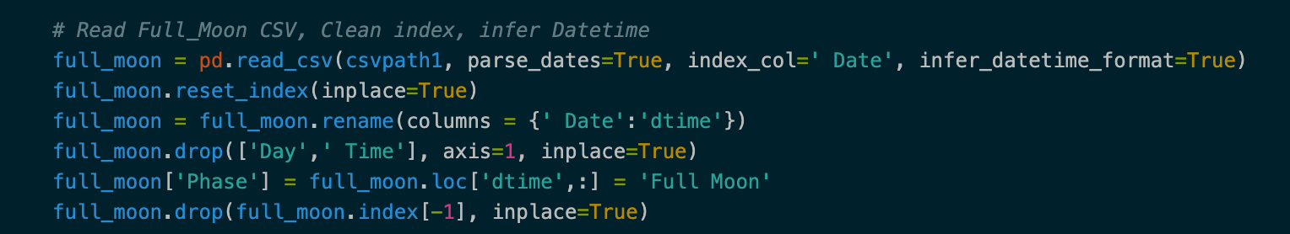
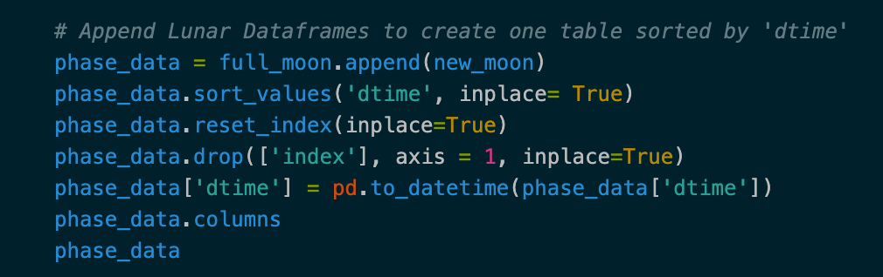
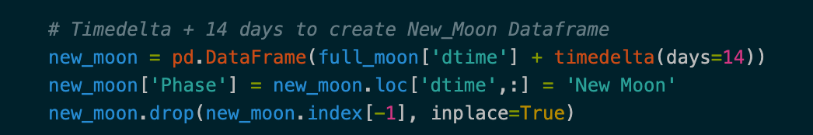
The Challenger

Slide 8
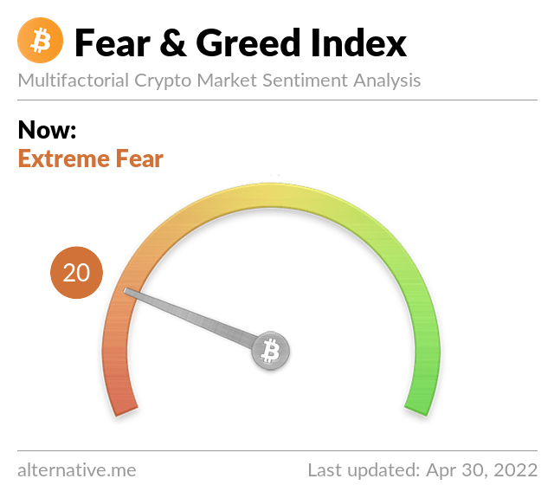
Fear in the market
blood in the streets
The fear index could act as a predictor for breaks in the trend.

Slide 9
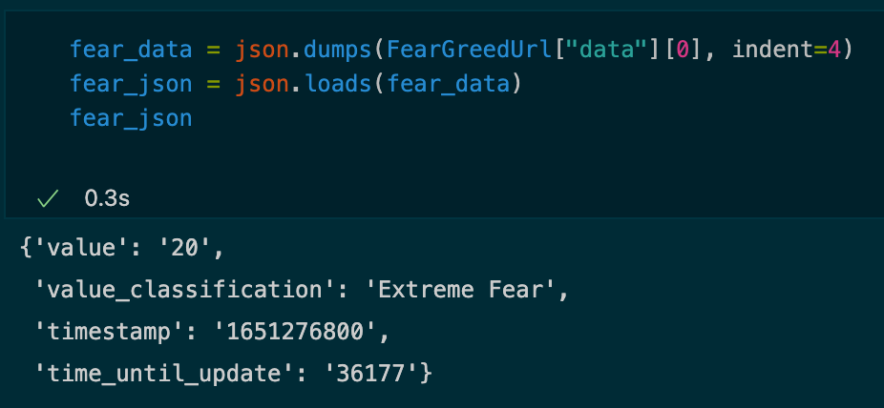
Fear Index

Slide 10
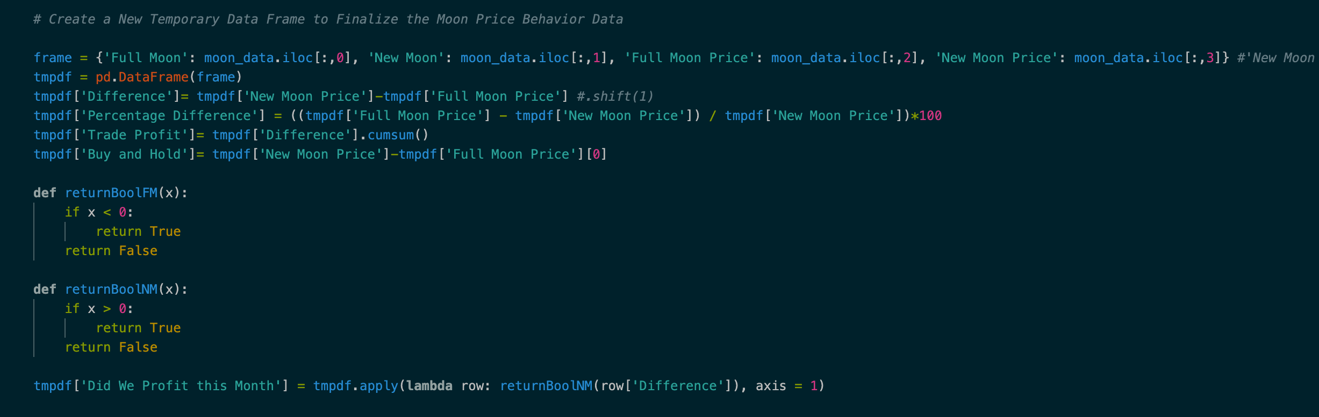
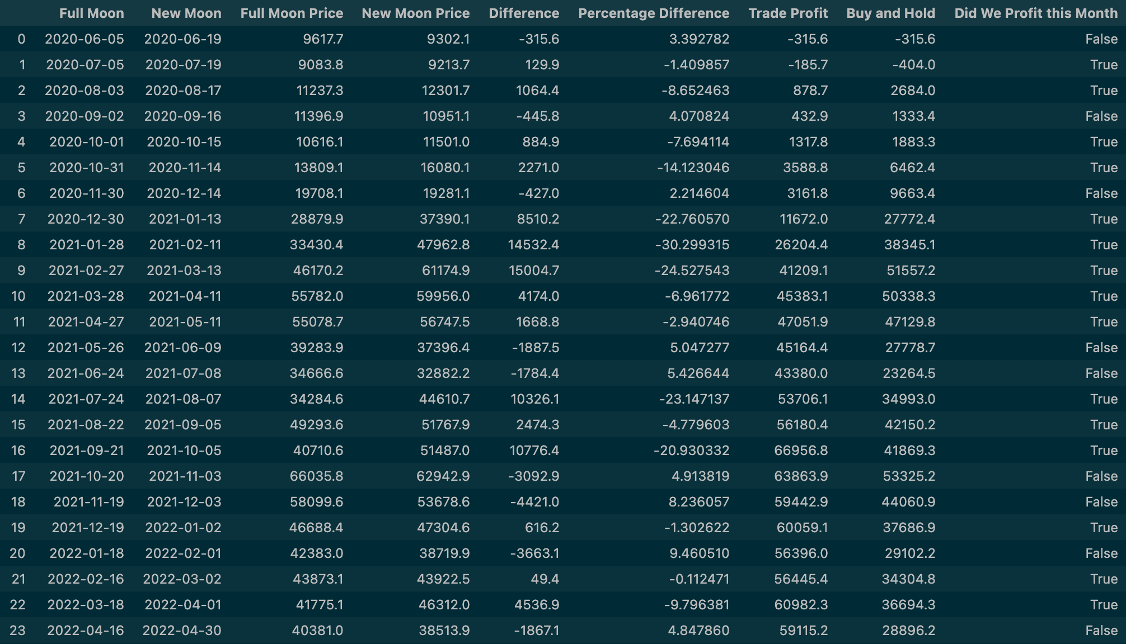
BOOLean Data

Slide 11
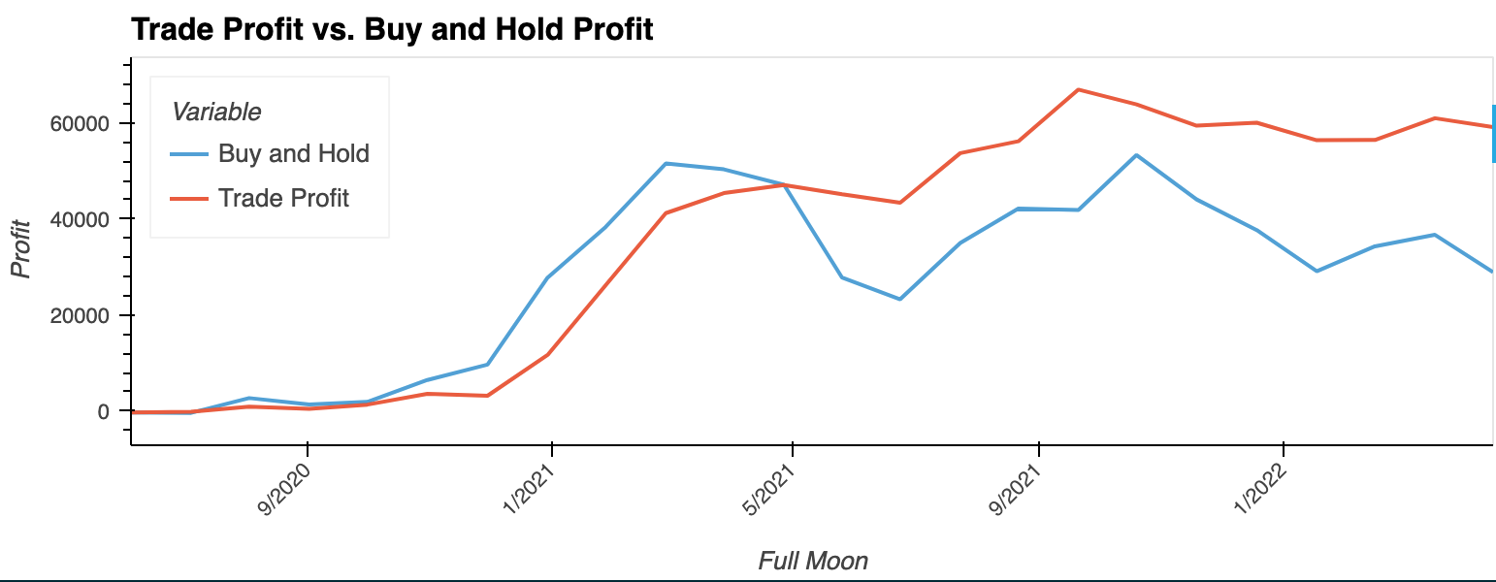
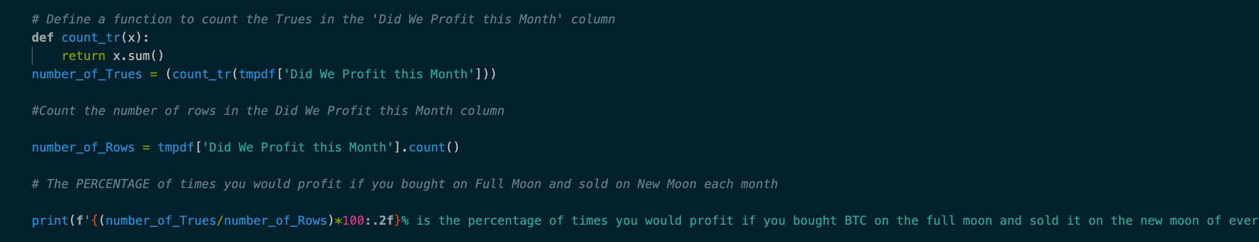
The Moon and BTC
Correlation results
Buy at the Full Moon, Sell at the New Moon has a 62.5% success rate

Slide 12
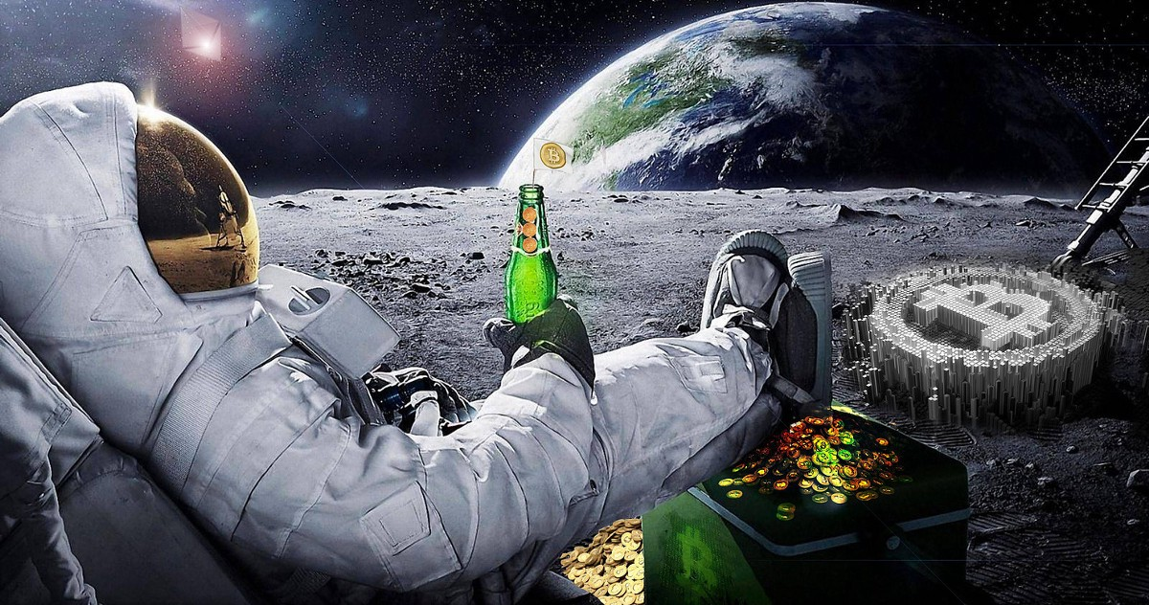
General Conclusions
what you need to know, according to the moon boys
The moon moves the markets, but there are other factors that need to be weighed for more accurate predictions.

Slide 13
Asked and Unanswered
The ones that got away
We believe the Fear Index can be a powerful indicator in predicting ‘False’ Moons and changes in trend.

